Slide 1


Facility Management System
Developed BY

Slide 2
INTRODUCTION
Streamline operations seamlessly with our all-in-one Facility Management System. From efficient Visitor Management to streamlined Material Movement, coordinated Daily Help management, real-time Communication, Notifications, and a suite of additional features, we're your one-stop solution for comprehensive facility oversight and optimization.

Slide 3
FEATURES
Visitor Management
Daily Staff Management
Amenities Booking
Communication
Notice Board
Helpdesk
Accounting
Payments
Child Safety
Material Movement
Multi Property Dashboard

Slide 4


AVAILABLE ON PLATFORM
Web For
Admin /
Facility
Manager
App for
other
user

Slide 5
We are
The Terms ‘Fail Fast’, ‘Fail Often’ and ‘Fail Better’ are quite applicable in the context of start-ups. Nortcele endeavours to transform these slogans to ‘Succeed Fast’, ‘Succeed Better’ and Succeed Often’.

Slide 6
We are
Our team consists of veterans in the field of tech with decades of experience in building products related to
Web Development
App Development

Slide 7
We are
Embedded Systems,
Telecommunication,
Data communication,
Storage
Automotive, Automation including AI/ML.

Slide 8
INTRODUCTION
We have Solution for facilities management, which can be game changer for any business unit who have multiple unit to manage. Facility management software helps to run following units smoothly.

Slide 9

What Challenges do any business manager face?
In any business unit Business Managers may face following Challenges…

Slide 10
What Challenges do any business manager face?
1. Conflict Resolution:
The conflicts may be related to noise, parking, shared facilities, or other issues. Business manager need to develop effective conflict resolution strategies and processes to address these disputes and maintain harmony within the community.

Slide 11
What Challenges do any business manager face?
2. Maintenance and Upkeep:
Ensuring proper maintenance and upkeep of the community is essential. This includes managing common areas, landscaping, waste management, security, and utilities.

Slide 12
What Challenges do any business manager face?
3. Communication and Information Sharing:
Providing information about business events, updates, rules, and regulations can be a challenge, especially when dealing with a large number of staffs. Business manager need to establish effective communication channels and platforms to keep staffs informed and engaged.

Slide 13
What Challenges do any business manager face?
4. Managing Amenities and Facilities: Business units often provide amenities and facilities for their staffs. Ensuring these amenities are well-maintained, accessible, and meet staffs' needs can be a challenge. Business manager need to manage bookings, maintenance schedules, and address any issues or concerns related to these facilities.

Slide 14
What Challenges do any business manager face?
5. Financial Management:
Proper financial management is crucial for the sustainability of the business. Business managers must handle finances efficiently, allocate funds for business development and maintenance activities.

Slide 15




What Facility Management System(FMS) do?
Financial
Management
Stock & Inventory
Management
Contract &
Compliance
Management
Asset
Management

Slide 16




What Facility Management System(FMS) do?
Work Order
Management
Communication
Management
Visitor
Management
Daily Staff
Management

Slide 17



What Facility Management System(FMS) do?
Health, Safety & trainings
Blue collar recruitments
Suggestions & feedback

Slide 18

How FMS can be Beneficial for a Community Builder?
Branding:
Play a significant role in enhancing the branding of a business. It provides tools and features that enable business managers to establish and promote a strong and cohesive brand identity.

Slide 19


Stock & Inventory Management
Maintain Stock details and can be viewed by other team members.
Raise tickets for material requirement.

Slide 20


Asset Management
Maintain a track history of various assets.
Easily maintain & update health report of every asset

Slide 21


Contract & Compliance Management
Through app all documents will be easily accessible & get reminders for their renewal.
Keep track of third party vendor contract copies & receive reminder for their approvals.

Slide 22

Work Order Management
Work orders in Calendar view.
Complete work log for breakdown work orders

Slide 23


Visitor Management
Technologically forward pass code based solution that makes it easy for residents to participate in the process of approving their visitors.
Verify unexpected visitors.

Slide 24




Visitor Management
Get notified
on checkout attempt
Allow future exit.
Overstay alert
for business
executives.
Parcels Leave
at gate.

Slide 25




Communication Management
Run polls/
Discussions.
Send
meeting
invites.
Notice Boards/
Announcements.
Documents.

Slide 26



Daily Staff Management
Instant notifications on arrival of staff.
Attendance review.
staff ratings.

Slide 27




Helpdesk / Complaints Management
Quick complaint assignment
Escalation Matrix and information
Alert to technicians
Real-time updates

Slide 28


In-house & Third Party Application Accessibility
App tied up with various food brands & supermarkets.
Shopping of various products can be done through application & get cashback/offers.

Slide 29



Health, Safety & Trainings
Emergency evacuation plan is easily accessible
Health status of Daily helpers & drivers.
Medical Emergency services

Slide 30


Blue Collar Recruitments
Find suitability & employment-soft & technical services
Data bank of Referrals

Slide 31

Suggestions & Feedback
Suggestion & feedback will be always welcome from our customers.

Slide 32
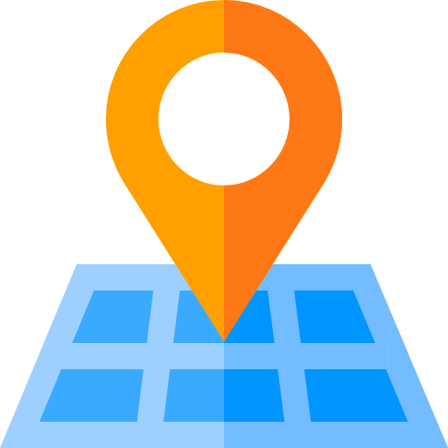
For more details reach us at
Nortcele Systems Private Ltd.
2nd floor, #78, B. K. Plaza,
Kagadasapura main road,
Vignan Nagar, New Tippasandra Post, Bangalore-560075, Karnataka, India.
Contact Number : +91 8041263798
Email : contact@nortcele.in
Website: nortcele.in

Slide 33

THANK YOU
Team Nortcele Systems

